Slide 1
Customer Development Hypotheses Presentation
Erik Wilkinson

Slide 2
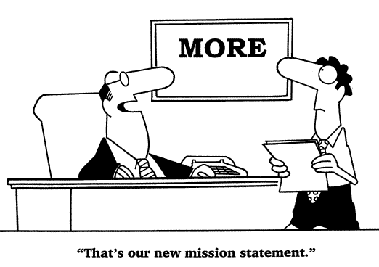
Mission Statement
To make managing the scheduling of classes and/or rooms easier for Cal Poly professors and staff, via the development of software?

Slide 3
Core value of project
To pass a required class?
To bolster our resumes?
Because making software is cool?
To make life easier and simpler for people, so they can focus on things that really matter (such as teaching)?

Slide 4
Customer development process
Product
Customer and their problem
Channel and Pricing
Demand creation
Market Type
Competition

Slide 5
1. The Product
Features
Benefits
Dependency Analysis
Product delivery schedule
Total cost of ownership/adoption

Slide 6
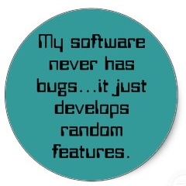
A. Features
Top 10 (or fewer) features of software
Based on engineers’ perceptions
To be key (and ranked via importance) deliverables, with all else secondary
Can be revisited as knowledge changes

Slide 7
A. Features: cont’
Off of Website:
a database of instructor information, including course teaching preferences and teaching time preferences
a database of a department's course offerings, including courses planned for particular quarters
a database of rooms in which courses can be offered
the ability to define department-specific scheduling constraints to guide the scheduling process
a scheduling algorithm that generates an optimized schedule, based on instructor preferences, planned course offerings, available rooms, and departmental constraints
the ability to fine tune a generated schedule, with automated checking to ensure completeness and consistency
a variety of schedule viewing forms, including tabular views and calendar-based views
interface to the campus-level scheduling database, for submitting completed schedules to the registrar's office
facilities to archive past schedules, and use them as starting points for new schedules
the ability for students to access published schedules, and provide simple input to aid the scheduling process

Slide 8
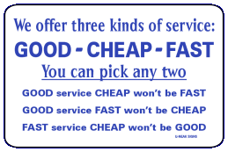
B. Benefits
Time saving?
Data more manageable?
What are the real benefits?

Slide 9
C. Dependency analysis
For the product’s success, here’s what needs to happen that’s out of our control:
Registrar doesn’t get mad at us
People are adaptable to change and using software
What else?

Slide 10
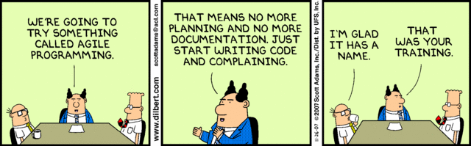
D. Delivery schedule
Not only first release date, but follow-up releases, and long-term plan
Clarification, plan needed tentatively in writing in one place

Slide 11
E. Total cost of ownership/adoption
How much will it cost to implement the software?
Time to train users?
Time to support use?
Will the users be dramatically affected/forced to change their lives due to implementation?

Slide 12
2. The Customer and their problem
Types of Customers
Customer Problems
A Day in the Life of a Customer
Customer Influence Map
Minimum feature set

Slide 13
A. Types of customers
End users – professors and staff
Influencers – people who influence implementation decisions. Deans? Students?
Decision makers – head of departments? Other?
Saboteurs – people who like the status quo. Entrenched departments? Full-time schedulers? The registrar?

Slide 14

B. Customer problems
“If you could wave a magic wand…”
Scheduling takes time
Is a pain?
Define precise customer
problems we’re solving

Slide 15
B. Customer problems - cont’:
Seriousness of need?
Latent Need (the customers have a problem or they have a problem and understand that they have a problem).
Active Need (the customers recognize a problem--they are in pain--and are actively searching for a solution, but haven’t done any serious work to solve it yet).
Vision (the customers have an idea what a solution to the problem would look like, may have cobbled together a homegrown solution, and might even be prepared to pay for a better solution!).
Are we solving a Mission Critical problem? Is the solution only nice-to-have?

Slide 16

C. A day in the life of the customer:
Available from the interviews somewhat
How would their lives change? How would they spend their days?
How much time would they save – in hours?

Slide 17
D. Customer Influence Map
Decision Makers
End Users
Influencers
Saboteurs

Slide 18
E. Minimum Feature Set
What is the smallest set of features acceptable in a final release?
What is the smallest or least complicated problem?
Is that our focus in the current releases?

Slide 19
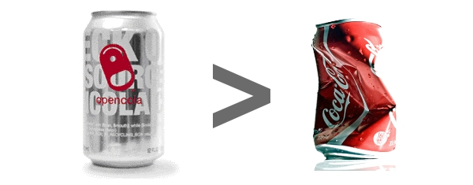
3. Channel and Pricing
Free (for now), but with maintenance costs down the road?
Distribution – online, for now?

Slide 20
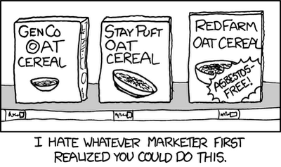
4. Demand creation
Product presentations?
In-person interviews?
Advertising – Video, paper, website, or otherwise?

Slide 21

5. Market Type
Entering an Existing Market
Resegmenting an Existing Market
Entering a New Market

Slide 22
6. Competition
If the market doesn’t yet exist, how do users get by without the software today?
Do they simply not do something or do it badly?
Would any other software be
“satisfactory”?

Slide 23

Branding
Delivers the message clearly
Confirms our credibility
Connects our target prospects emotionally
The external image of our product, and how it is perceived.
How do we want ourselves and our software to be viewed?

Slide 24

Branding: Current
Student project, not professional
This should affect our branding and exterior image, not our actual work

Slide 25

Branding: Future
Professional, reliable, student originated project
Tested with professors
Commercial-quality

Slide 26
Logo and Naming
Logo:
Working with Jake for mockups
Will be contacting GRC as well, if only for advice.
Naming:
Tempus” only tentative

Slide 27
